Slide 1
Unit 7 Final capstone project
Medical X-ray image classification
Nagadhara Dronadula

Slide 2
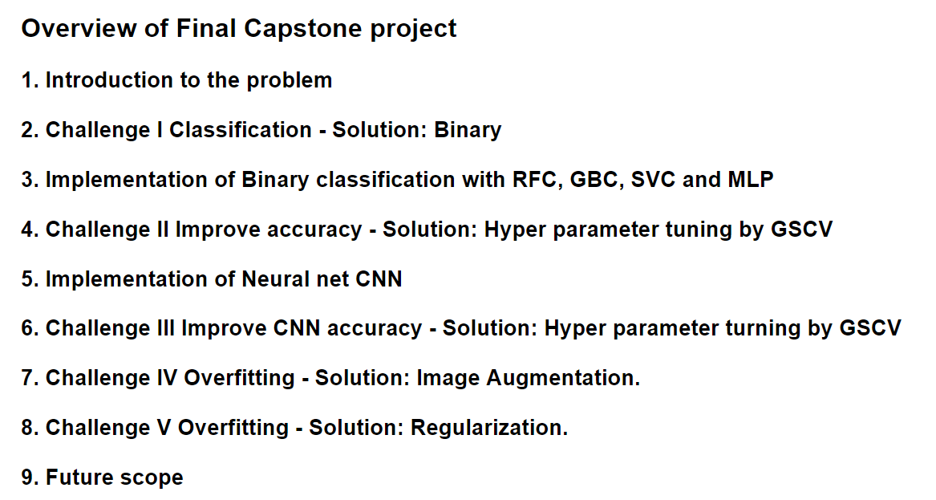

Slide 3
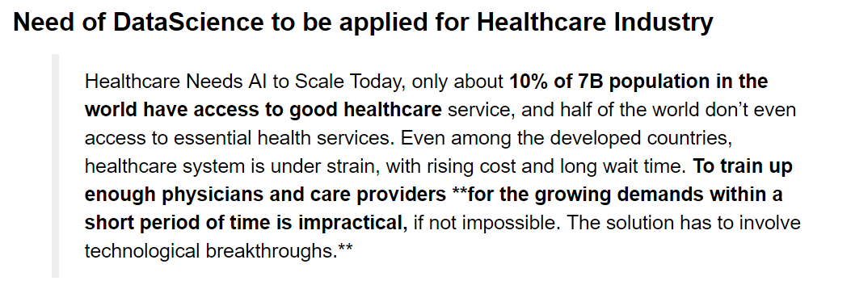
From: https://towardsdatascience.com/can-machine-learning-read-chest-x-rays-like-radiologists-part-1-7182cf4b87ff

Slide 4
Dataset is NIH Chest X-ray Dataset from Kaggle website.
Source: Full dataset 112,000 images -https://www.kaggle.com/nih-chest-xrays/data
Before going with the full dataset went ahead to test the process with a sample dataset.
Source: Sample dataset 5606 images (5% of full data)-https://www.kaggle.com/nih-chest-xrays/sample

Slide 5
Why Medical images are most challenging to work with?
Most existing computer vision neural networks are designed for colorful natural images and takes advantage of the rich textures present in them. This makes it hard to directly apply off-the-shelf solutions on CXRs (Chest X-Rays).
Data limitations:
1. The image labels are NLP extracted so there could be some erroneous labels but the NLP labeling accuracy is estimated to be >90%.-----This limits our Final TEST accuracy to some extent.
2. Very limited numbers of disease region bounding boxes (See BBox_list_2017.csv)
3. CXRs radiology reports are not anticipated to be publicly shared. Parties who use this public dataset are encouraged to share their “updated” image labels and/or new bounding boxes in their own studied later, maybe through manual annotation

Slide 6
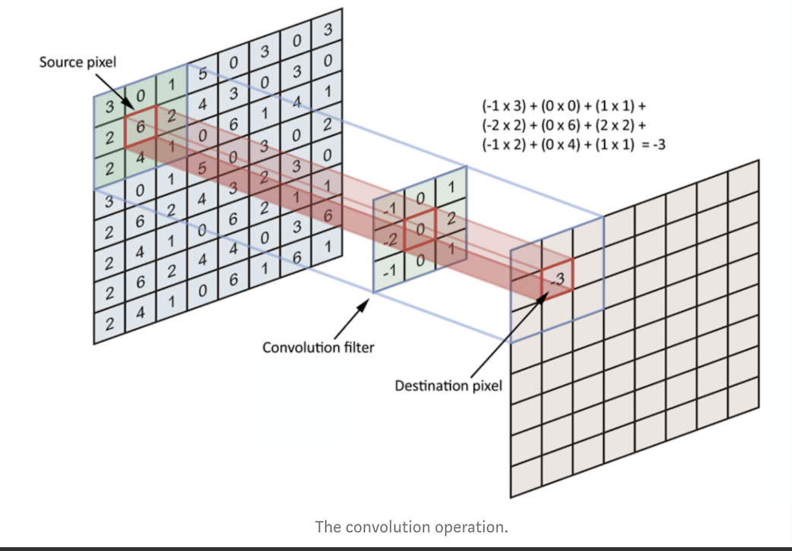
A convolution operation
SOURCE: https://towardsdatascience.com/simple-introduction-to-convolutional-neural-networks-cdf8d3077bac

Slide 7
Research question:
Can the X-ray images of Lung disease be classified into disease and no disease by the machines?

Slide 8
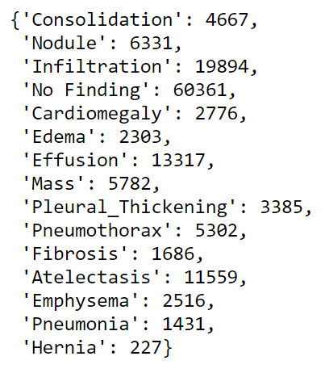

Slide 9
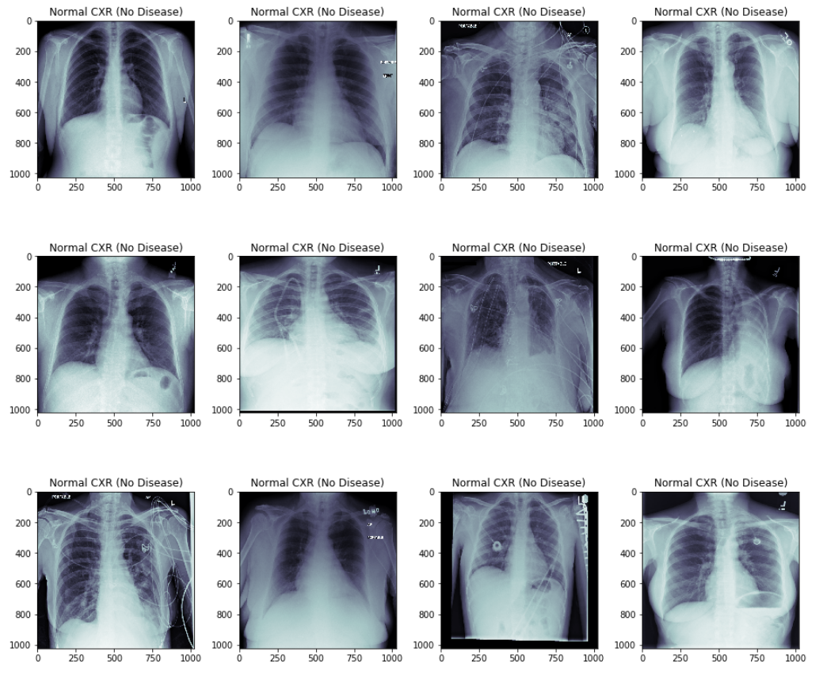

Slide 10
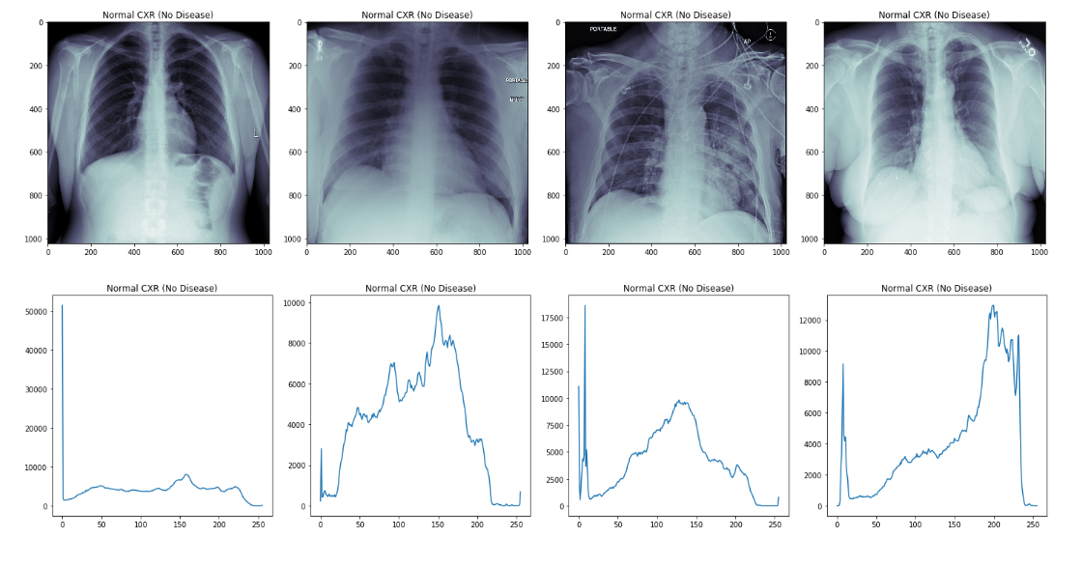
histograms

Slide 11
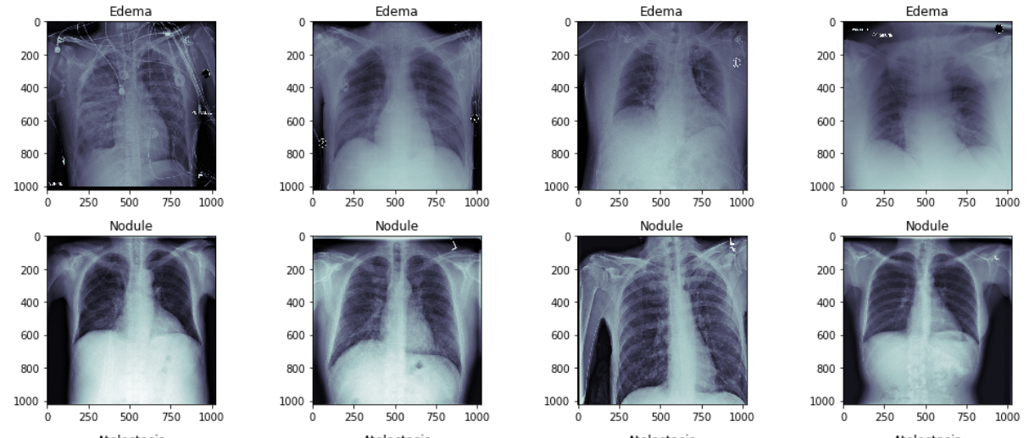

Slide 12
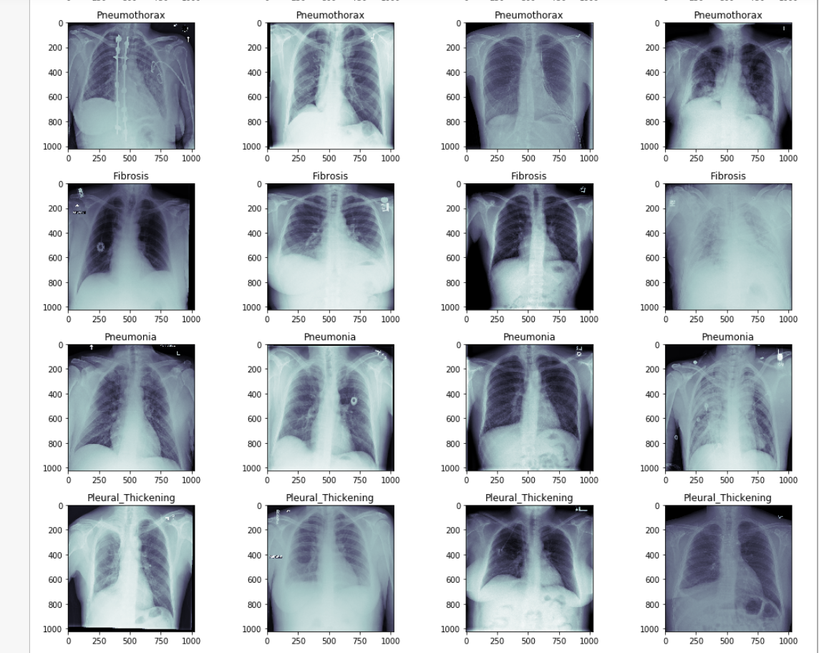

Slide 13
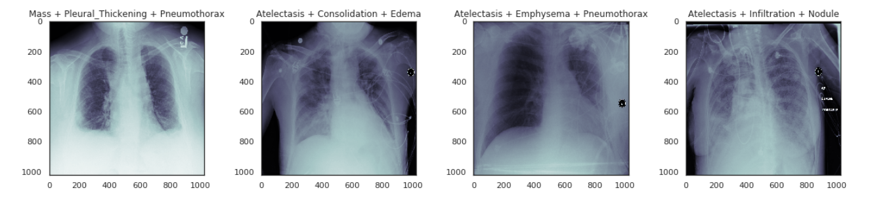
Multi label multi class

Slide 14
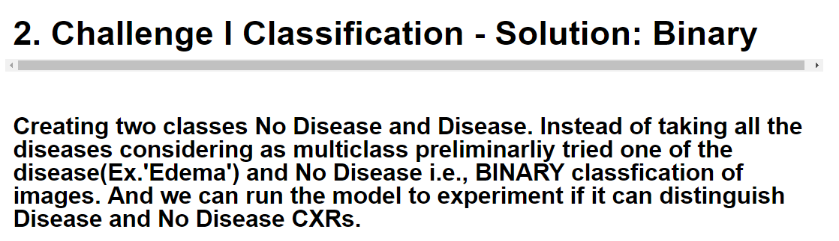

Slide 15
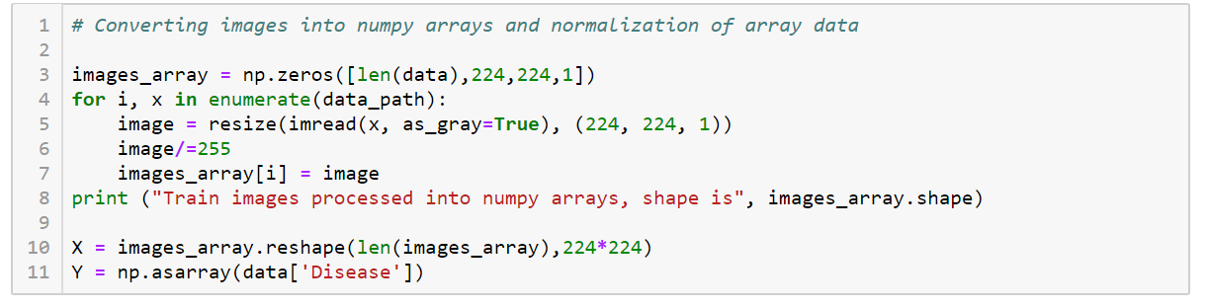
Conversion of images into image arrays

Slide 16
BEFORE
AFTER
MODEL | TRAINING ACC. | TESTING ACC. | TRAINING ACC. | TESTING ACC.
RFC | 0.98 | 0.67 | 1.00 | 0.75
GBC | 1.00 | 0.63 | 1.00 | 0.63
SVC | 0.52 | 0.51 | 0.51 | 0.52
MLP | 0.81 | 0.67 | 0.77 | 0.66

Slide 17
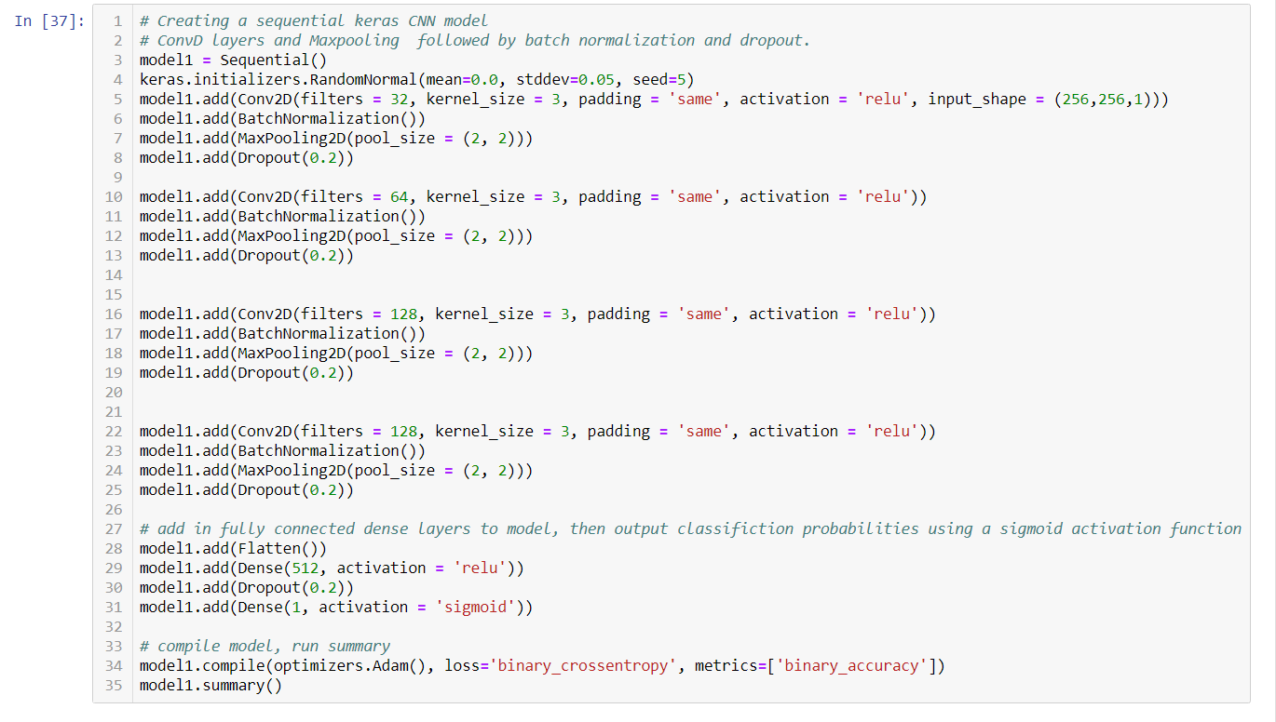

Slide 18
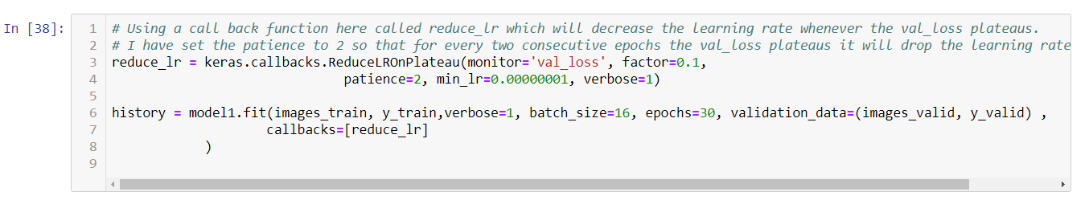
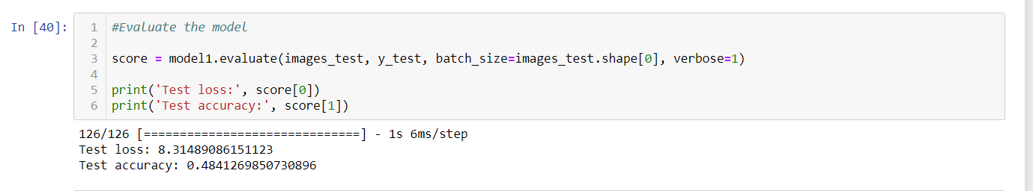

Slide 19
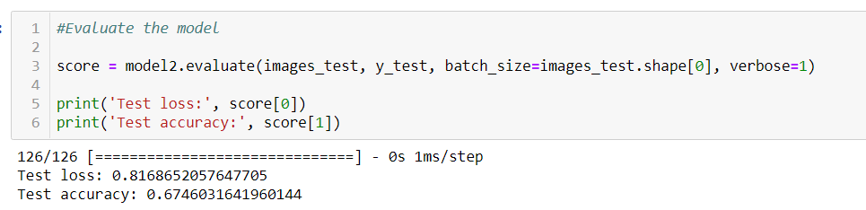
48
67

Slide 20
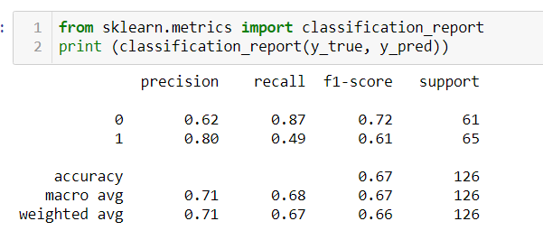

Slide 21
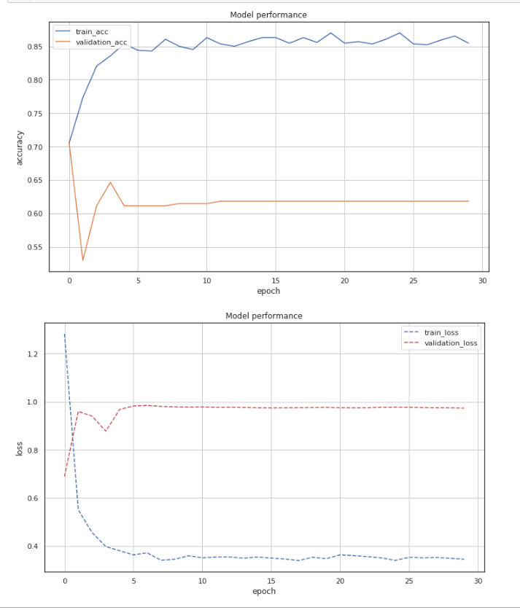

Slide 22
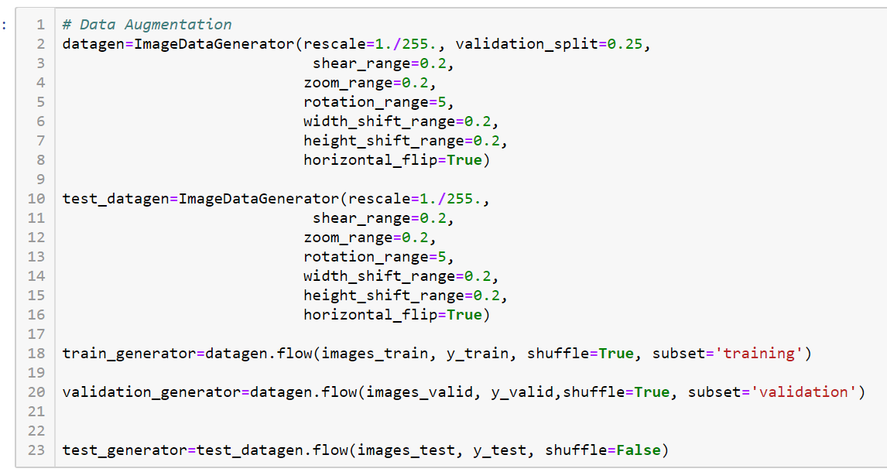

Slide 23
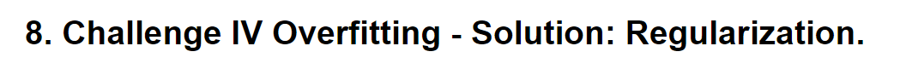
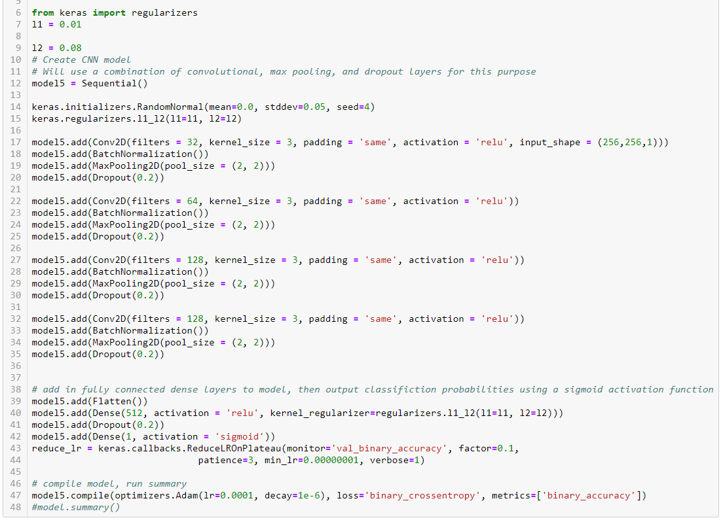

Slide 24
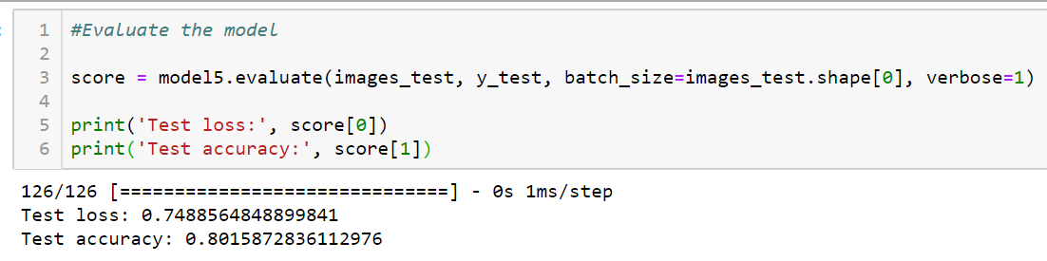
48
67
80

Slide 25
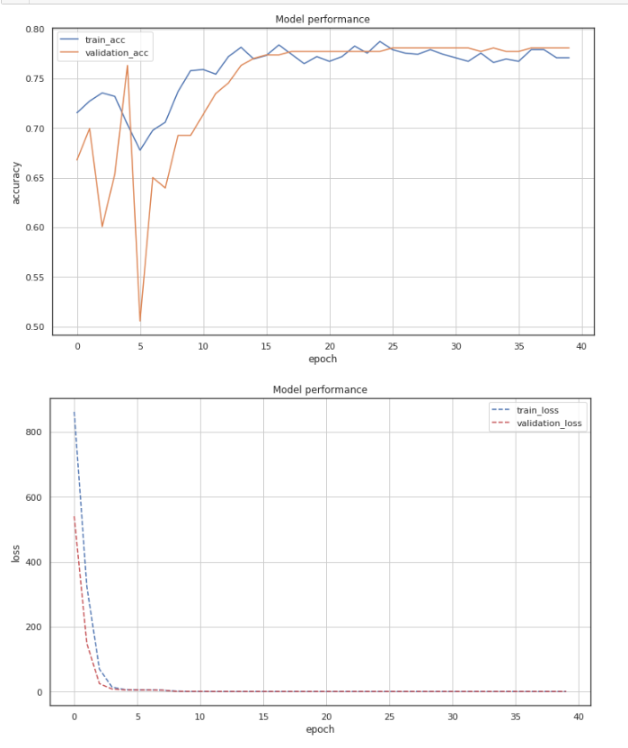

Slide 26
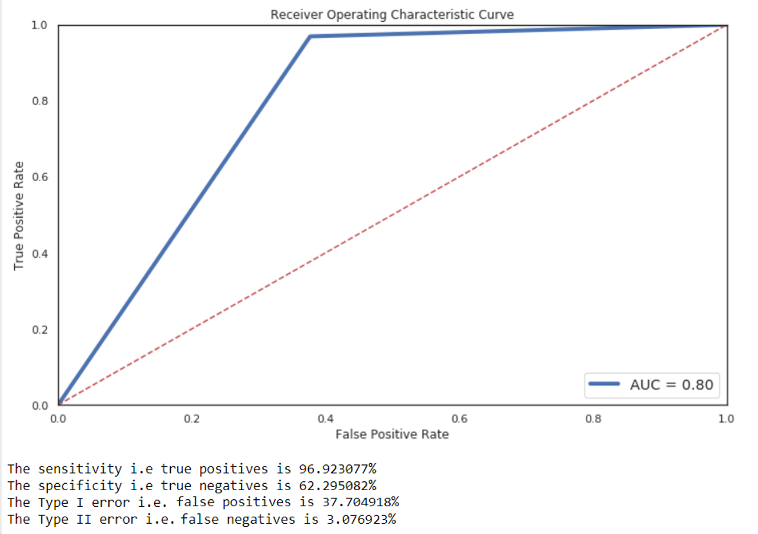

Slide 27
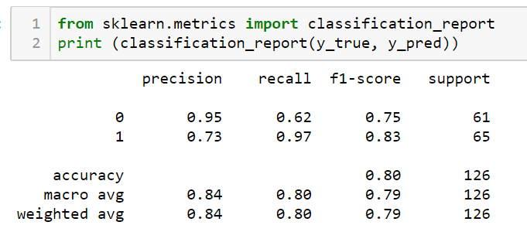

Slide 28
Short comings of the model
One major short coming is the absence of high end resources like high GPU power i.e. Parallel processing cores, high amount of RAM.
CNN as any Neural nets need lot of images. Couldn’t supply more.

Slide 29
conclusions
Neural networks need to be tuned to derive maximum benefit/accuracy. The quality of the data input can never be overstated i.e., garbage in garbage out, which determines the success of any modelling technique.
The medical imaging datasets are especially challenging to handle given great variation which becomes a problem since it is hard to decipher patterns in the data.

Slide 30
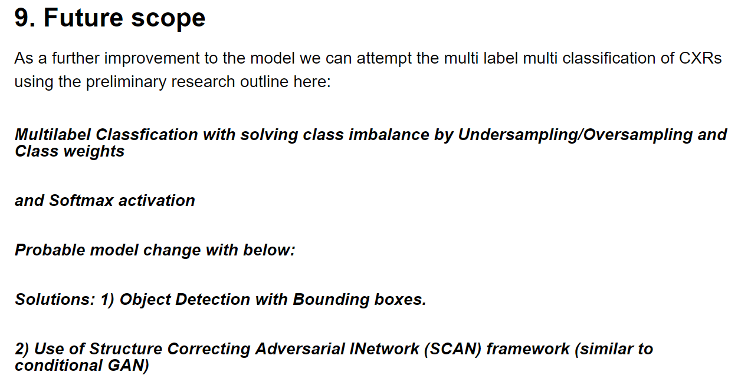

Slide 31
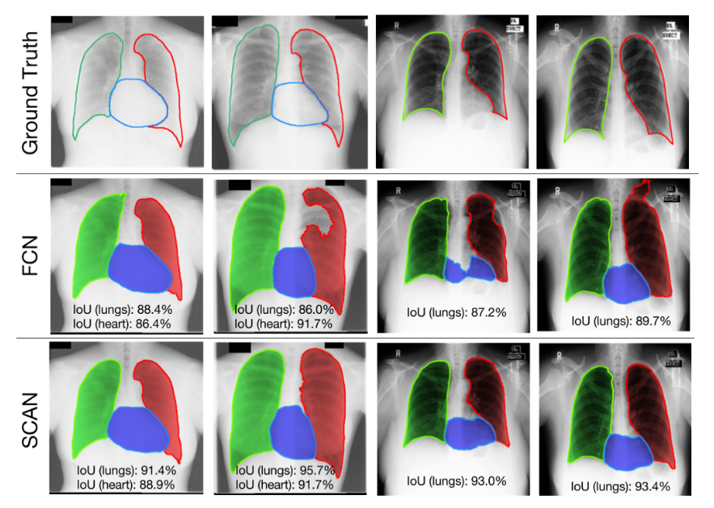
Objective: Cardiomegaly enlarged heart creates bigger space between the lungs. which can be measured after the drawings of the lungs and the heart accurately. So segmentation of the organ boundaries or masks is necessary for this purpose.
Figure legend:
Top panel:
Ground Truth
Middle panel:
FCN is from Fully Convolutional Network drawn - Mistakes
Bottom panel:
SCAN two networks Discriminator Network (D(x)) and Generator Network (G(z)). Perfect boundaries
Source: Evaluation on JSRT dataset. (Candemir et. al., TMI (2014)) Research paper

